Slide 1
A Maximum-Likelihood Approach to Single-Particle Image Refinement
Author: F.J.Sigworth
Yale University School of Medicine
Presented by: Weihong Li

Slide 2
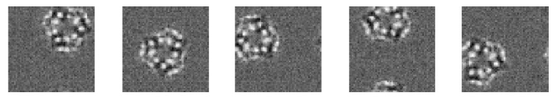
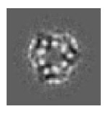
Single-particle Alignment
What is this?
Some examples.

Slide 3
Cross-correlation method
Maximizing the cross-correlation of images, followed by averaging of images thus aligned, is the standard method for combining the images of randomly positioned particles (Saxton and Frank, 1977)

Slide 4
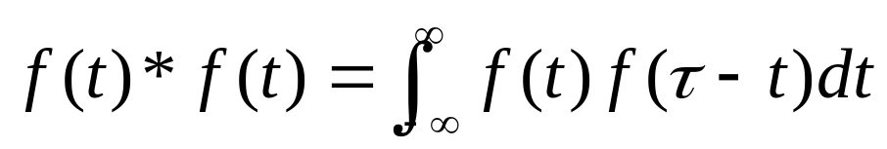
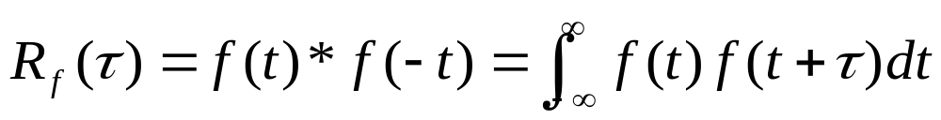
Cross-correlation method (Cont.) Preliminary
Autocorrelation
  The self-convolution of a function is:
  If we do not reflect one term in the product, we form instead the autocorrelation function:
  The autocorrelation function is always even and has a maximum at t=0.
(K.R.Castleman Digital Image Processing 1996)

Slide 5
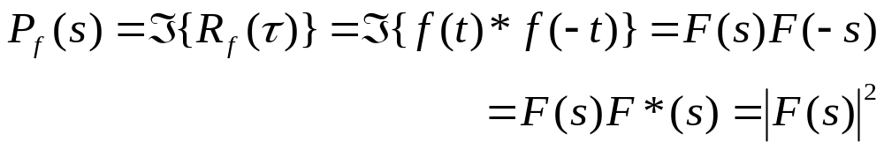
Cross-correlation method (Cont.) Preliminary
The Power Spectrum
  The Fourier transform of the autocorrelation function is:
  and is called the power spectral density function or power spectrum of f(t). If f(t) is real, its autocorrelation function is real and even, and therefore, its power spectrum is real and even.
(K.R.Castleman Digital Image Processing 1996)

Slide 6
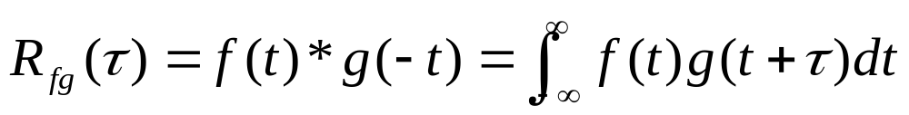
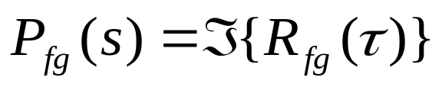
Cross-correlation method (Cont.)
Give two functions f(t) and g(t), their cross-correlation function is given by:
The cross-correlation function indicates the relative degree to which two functions agree for various amounts of misalignment(shifting)
The Fourier transform of the cross-correlation function is the cross power spectral density function of cross power spectrum .
(K.R.Castleman Digital Image Processing 1996)

Slide 7
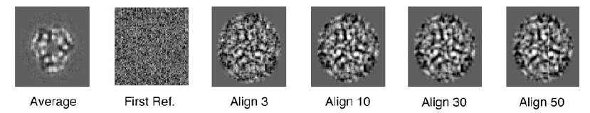
Weakness of the method
However, the method fails at low signal-to-noise ratios and small particle sizes, because noise produces false peaks in the cross-correlation function used for alignment.

Slide 8

Maximum-Likelihood Method
Maximum likelihood, also called the maximum likelihood method, is the procedure of finding the value of one or more parameters for a given statistic which makes the known likelihood distribution a maximum. The maximum likelihood estimate for a parameter is denoted
For a normal distribution,
.
(Courtesy of Mathworld.wolfram.com)

Slide 9
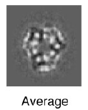
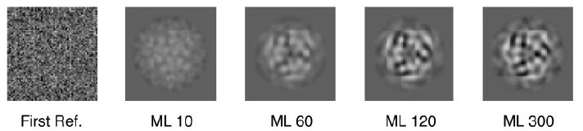
Maximum-Likelihood Method
The alogorithm forms a weighted sum over all possible in-plane rotations and translations of the image
The weighting factors, which are the probabilities of the image transformations, are computed as the exponential of a cross-correlation function.

Slide 10
Motivation of the paper
An important approach to the determination of macromolecular structures is the analysis of the images of randomly oriented single particles
  Smaller particles cannot be aligned because the signal-to-noise ratio of low-dose images does not allow the position and orientation of particles to be determined unambiguously.
Can this information be somehow used to obtain high-resolution structures from large ensembles of small-particle images?

Slide 11
The Goal of the paper
This paper considers a maximum-likelihood approach to the problem of recovering 2D structural information from a set of small-particle images
The goal is to obtain a reconstructed projection image from a large number of such data images.

Slide 12
About the data images
We assume that these data images have been obtained from a population of identical particles that are oriented normal to the support film, so that they present an identical view.
However, the orientation of the particles in the plane of the support film is random.
Therefore, each individual data image contains the projection of the particle whose position relative to the center of the image and whose rotation angle are not precisely know.

Slide 13
Review of the alignment problem
Maximizing the cross-correlation of images, followed by averaging of images thus aligned, is the standard method for combining the images of randomly positioned particles (Saxton and Frank, 1977)
Refinement step of the reference-free alignment procedure is described by Penczek et al. (1992)

Slide 14

Details of cross-correlation method (1)
To get formal expression, we shall assume that each of the N images is a noisy, translated, and rotated copy of the underlying true structure W, to which white Gaussian noise has been added.
The white Gaussian noise is one of the white noise, which is noise with autocorrelation function zero everywhere but at 0, and is also called Johnson noise. It has a frequency spectrum. The noise produced by a resistor is white noise. (Courtesy of Science
World.Wolfram.com)

Slide 15
Details of cross-correlation method (2)
Then, the ith image is described by:
where z is a scaling factor and Gi is the noise. The SNR defined as the ratio of signal variance to noise variance (Frank, 1996), is proportional to z².
describes that the true structure W is mapped onto a transformed coordinate system, the following slide shows the examples of these images.

Slide 16
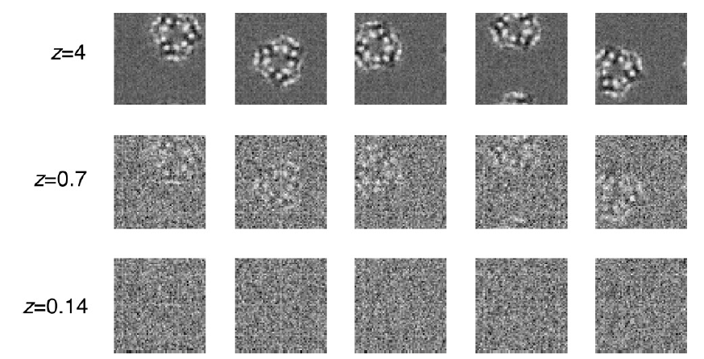
Details of cross-correlation method (3)
These data have signal amplitudes z=4,0.7 and 0.14, which has SNR of 16,0.5 and 0.02

Slide 17
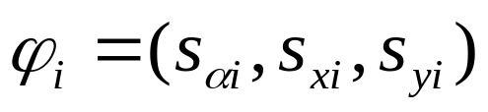
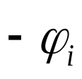

Details of cross-correlation method (4)
Since the transformation is parameterized by the rotation angle and the x and y translations, so that we write for
  defines the transformation applied to the structure. The inverse transformation returns the structure to its standard position
  Letting j be the index of a pixel in the image, the value of an indiviual pixel in X_{i} is x_{ij}

Slide 18
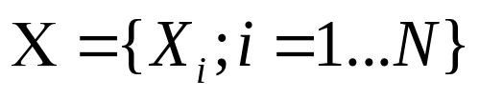
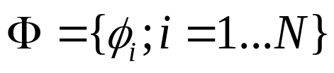
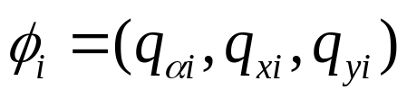

Details of cross-correlation method (5)
The goal of the refinement is to determine for the data set a set of transformation parameters
,where is the triplet of parameters for optimal alignment of image

Slide 19
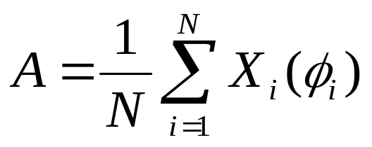

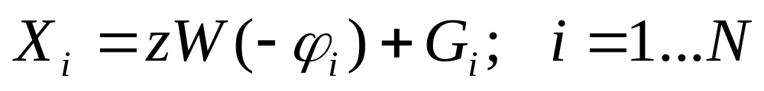
Details of cross-correlation method (6)
Given the set of parameters, the average image
will be an optimal estimate of the original structure
if the are equal to the true transformations in

Slide 20

Details of cross-correlation method (7)
How to find the parameters?
  The alignment parameters can be found by optimizing any of a number of related quantities (Penczek et al., 1992). One of these is the squared magnitude of the summed images,

Slide 21



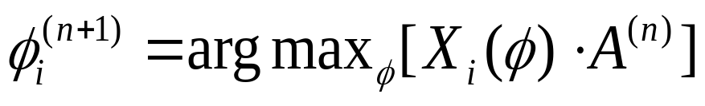
Details of cross-correlation method (8)
How to find the parameters?
  We can get a local maximum of previous function by iteration as follows:
  Given the alignment after n iterations and the corresponding average , and improved alignment set is obtained by maximizing the cross-correlation between each image and the average.

Slide 22
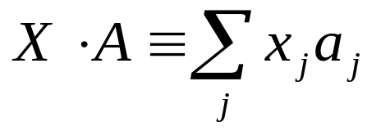
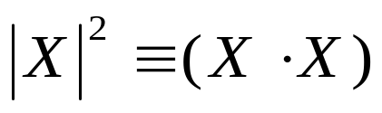
Details of cross-correlation method (9)
How to find the parameters?
  The dot in previous function indicates an inner product between the images, such that
  The squared norm of a particular image X is defined as

Slide 23


Details of cross-correlation method (10)
How to find the parameters?
  To make the result less dependent on the initial alignment parameters, Penczek et al. (1992) first subtract the old contribution of to before performing the cross-correlation
  Then, given the improved alignment set , a refined average
  is obtained as

Slide 24
Cross-correlation method (Summarized)
  By repeating steps (4) and (5) in previous slide, a local maximum of the function in equation (2) is approached.
  If the signal-to-noise ratio is sufficiently high, the correct alignment parameters will be found and the global maximum will correspond to an estimate A that is closest to the true structure W in a least-squares sense.
  However, if the signal-to-noise ratio is low, false peaks in the cross-correlation function result in errors in the determination of the alignment parameters in Eq.(4) and the algorithm may converge to a maximum of Eq. (2) that does not correspond to the true structure.

Slide 25
Maximum-Likelihood Refinement (1)
  We use an alternative approach that provides a maximum-likelihood estimate of the original structure W. As before, a function of the reconstructed image A is maximized.
  However, no alignment set is determined. Instead, the transformation variables are treated as hidden, random variables.
  The goal is to find the most likely parameter values for a model that describes the data set X.

Slide 26

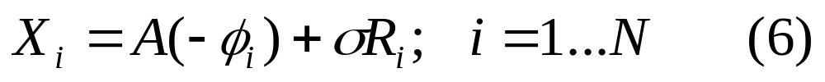




Maximum-Likelihood Refinement (2)
    We need to create an appropriate model contains the estimate A of the underlying structure and a formal description of the noise and parameters , which describe the statistics of the transformations
    We assume there is a model which describes the data image as:
  This model has the set of parameters .Because this model has the same form as that which gives rise to the data (Eq.(1)), an estimated structure A should approach the true structure zW.
  The parameter is the standard deviation of each pixel of the added Gaussian noise, taking the to be independent, white Gaussian noise images of unit variance. The individual transformation variables are taken to be independent triplets of random variables whose probability distribution is parameterized by .

Slide 27

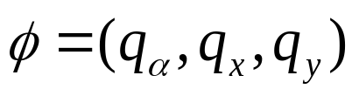
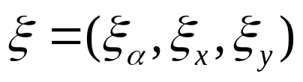



Maximum-Likelihood Refinement (3)
  The data set is imagined to arise from a selection process in which a large micrograph is scanned to detect particles, and small images X_{i} are extracted with one particle roughly centered in each image.We assume that this approximate centering of the particles leaves residual random transformations which are Gaussian-distributed in x and y and uniformly distributed in the rotation angle .
  Letting and , the probability density of the transformation variables is given by

Slide 28

Maximum-Likelihood Refinement (4)
  The function to be optimized is the likelihood, which is the probability that a particular data set X arises from the model with parameter set ,

Slide 29

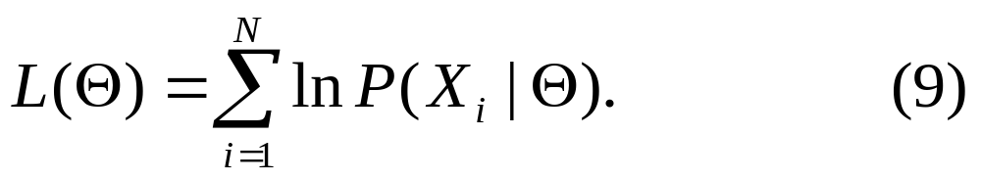
Maximum-Likelihood Refinement (5)
  To maximize the likelihood is equivalent to maximizing its logarithm . Because we assume the independence of the random variables associated with the individual images, will be the sum of the log likelihoods of the individual images,

Slide 30




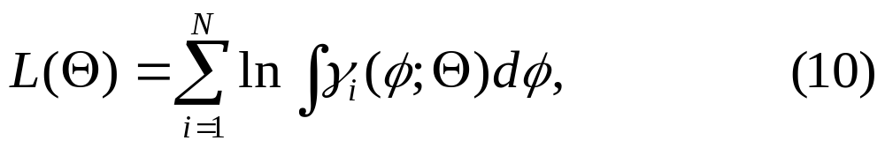

Maximum-Likelihood Refinement (6)
  In order to evaluate the probability of observing the data image given the model parameters ,we expand it as an integral over all possible values of the transformation as
  Where
  Here is the probability density given in Eq.(7). The other factor is the probability of obtaining an individual image given and .

Slide 31



Maximum-Likelihood Refinement (7)
  Taking the value of each pixel to be a continuous variable and with the assumption of white Gaussian noise in each data image, the probability density is a product of Gaussians representing the noise distribution in each of pixels:
  Equations(7) and (10-12) therefore allow the log likelihood to be evaluated for a given value of the parameters of the model.

Slide 32
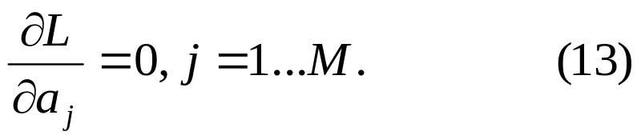
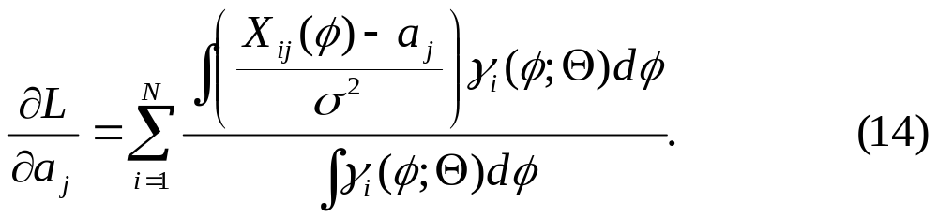
Maximum-Likelihood Refinement (8)
  A local maximum of the likelihood is attained by finding those parameter values at which the partial derivatives of the log likelihood are zero. For example, optimum values of the individual pixels a_{j} of the structure estimate A are found by setting
  These partial derivatives are given by

Slide 33



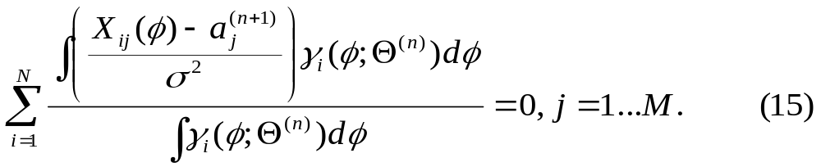
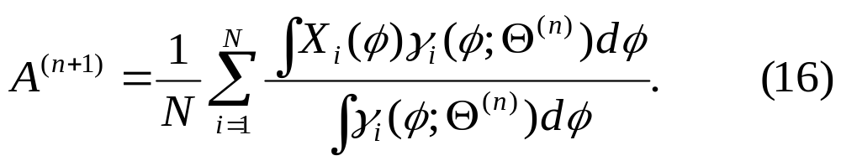
Maximum-Likelihood Refinement (9)
  Given an estimate of the parameters(which include the pixel values ) from the nth iteration, an improved set of pixel values is obtained by solving
  The solution is:

Slide 34



Maximum-Likelihood Refinement (10)
  The other model parameters also can be optimized concurrently with the pixel values. The noise standard deviation can be reestimated by approximating ,yielding the formula:

Slide 35






Maximum-Likelihood Refinement (11)
  Taking the functional form given in Eq.(7) and approximating the solutions to and , we obtain reesitmated values of and . The reestimation formula for is:
  Where q_{x} is the x-displacement component of the transformation .

Slide 36




Maximum-Likelihood Refinement (12)
  Similarly, a reestimation formula for the standard deviation of the translations is given by
  The maximum-likelihood refinement algorithm makes use of Eqs.(16)-(19). Given an estimated of the model parameters, these equations provide a set of parameters which increases the likelihood of the model.
  The set includes improved and the other model parameters, whose optimization is necessary to ensure the fidelity of the estimated structure.

Slide 37




Maximum-Likelihood Refinement (13)
  About the implementation

Slide 38
Maximum-Likelihood Refinement (14)
  Taking the value of each pixel to be a continuous variable and with the assumption of white Gaussian noise in each data image, the probability density is a product of Gaussians representing the noise distribution in each of pixels:
  Equations(7) and (10-12) therefore allow the log likelihood to be evaluated for a given value of the parameters of the model.

Slide 39
Maximum-Likelihood Refinement (15)
  Taking the value of each pixel to be a continuous variable and with the assumption of white Gaussian noise in each data image, the probability density is a product of Gaussians representing the noise distribution in each of pixels:
  Equations(7) and (10-12) therefore allow the log likelihood to be evaluated for a given value of the parameters of the model.

